Slide 1
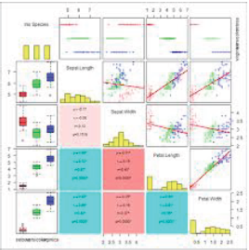
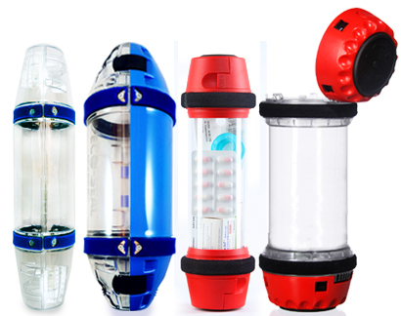
Your Title Here
Author 1, MD¹, Author 2, MD², Author 3, MD³, etc
Keck School of Medicine, ¹Departments of Internal Medicine and Pediatrics, ²Department of Family Medicine, ³Division of Medical Education, Los Angeles, CA, USA
Introduction/Background
Results
Discussion
Use either heading, but not both. In this section, “set the stage” by providing an overview of the subject being studied. For clinical research projects, include an introduction to the clinical condition.
The default font sizes used for this poster are generous, and can be decreased to no smaller than 25 pt if needed. Standard font size will be something that is readable from 3-5 feet. (28-36 pt)
This should be one of the larger, if not the largest section of the poster.
Use visual aids! However, make sure to include captions that help summarize or describe what the figure is intended to depict.
Results:
Report findings
No interpretation, though you can highlight your statistically significant findings (using a “pop” of color or boxing the significant columns/rows in a table
Remember that the tables, figures, and graphs used should be relatively self-explanatory in case you are not available to describe the data and findings. It is helpful to solicit the help of friends who are not involved in the research project, so they can tell you if they understand the basic findings without you describing them.
If no actual results yet: describe your expected results
This is the section where you will now interpret and analyze your findings. Did you reach your expected outcomes? What were some of the limitations and confounding factors/biases/etc that were encountered?
Here, you will also discuss if your results reached statistical significance and the overall clinical implications of your study and findings.
You can either create a separate heading that can describe the “Impact on the Field” of “Future Directions” to discuss what the next steps of your research might include, or its translational impact in the clinical realm.
Figure 1: Describe the findings that are illustrated in the table. A background box, such as this yellow box, can help align the figure within your column if desired to avoid trapped white space.
Objective/Hypothesis
This section should highlight the study aims for the project. Here, the questions/hypotheses should be introduced. This can be done in either bullet or paragraph form, depending on preference.
This section is also optional, since the Objectives/Hypothesis section can also be embedded within the Materials and Methods section.
Future Directions
Optional section, if not included in your Discussion/Conclusions section. Can also be a section that discusses the “Impact on the Field”
Materials and Methods
Describe the hypothesis here, if not separately discussed in a hypothesis section.
Here, you can describe the equipment used, setting, procedure, how data was analyzed, etc.
Ideally, integrate figures, images, tables, and graphs to accentuate this section to make it more visually appealing. For instance, you can include an algorithm or process map.
References
Choose your top 3-5 references to include. The font size for your references will typically be smaller than the text used in the rest of the poster. Typically, you can use the same font size as your captions, or slightly larger.
Keep in mind that the inclusion of a reference section on a poster is conference-dependent.
More often than not, references are listed on most posters, but there are a few conferences which have prescribed “headings” that should be included. (i.e. abstract section, reference section, objectives section, learning points, etc)
Contact Information
Optional section, if you want to include it and have space.. Can also substitute this section for “Acknowledgements.” Good luck!!
Notes:
1

